Slide 1
CIPD Coronavirus webinar series
Returning to the workplace: mitigate the divide
26 April 2021

Slide 2
Welcome
Lee Ann Panglea, Head of CIPD Scotland and Northern Ireland, CIPD

Slide 3
Today’s speakers
Lee Ann Panglea
Head of CIPD Scotland and Northern Ireland, CIPD
David D’Souza
Director of Membership, CIPD
Professor Rosalind Searle
Chartered Psychologist, University of Glasgow
Andy Dodman
Chief HR Officer, Leeds City Council

Slide 4
#StrongerWithCIPD
Covid-19 resources
NEW Well-being helpline
Employment Law helpline
Communities and branches
People Management
Knowledge and content
Free learning
Careers support
Professional creditability
Financial support
cipd.co.uk/memberbenefits

Slide 5
*New* Wellbeing Resources
We’ve partnered with Health Assured to support members mental health and wellbeing
Unlimited free 24/7 confidential telephone helpline, online portal & Health e-Hub app
The resource provides:
Legal information
Debt and financial information
Manager consultancy and support
Information on work and home issues
Factsheets, advice, information and self-help tools
Links to specialist support organisations
A resources area with; programmes, videos, webinars, medical information and mini health checks.

Slide 6
CIPD Perspective Trust and the return to the workplace
David D’Souza, Director of Membership, CIPD

Slide 7
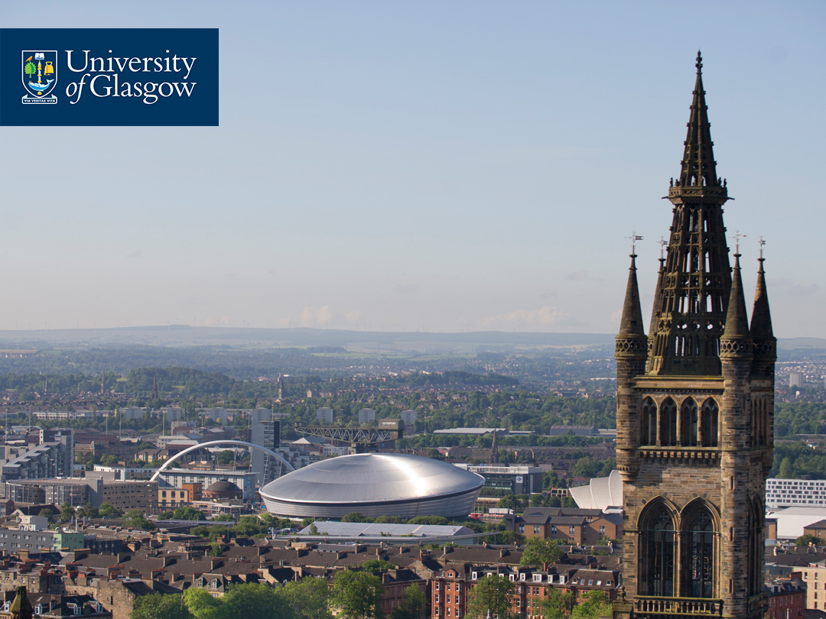
Why preserving organisational trust is a key HR strategy
CIPD Coronavirus webinar series: Returning to the workplace – mitigate the divide 26th April 2021
Prof. Rosalind Searle PhD., MBA FBPS, Chartered Psychol (occupational)

Slide 8
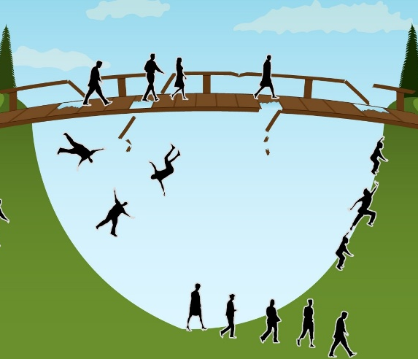
Returning to the workplace…
This Photo by Unknown Author is licensed under CC BY-ND
This Photo by Unknown Author is licensed under CC BY-NC-ND
This Photo by Unknown Author is licensed under CC BY-NC-ND
This Photo by Unknown Author is licensed under CC BY-SA
This Photo by Unknown Author is licensed under CC BY-SA
This Photo by Unknown Author is licensed under CC BY-SA

Slide 9
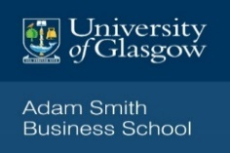
Heightening sense of
vulnerability
Trust
becomes a salient concern
Disrupts what is familiar,
creating ……
uncertainty
This Photo by Unknown Author is licensed under CC BY-SA

Slide 10
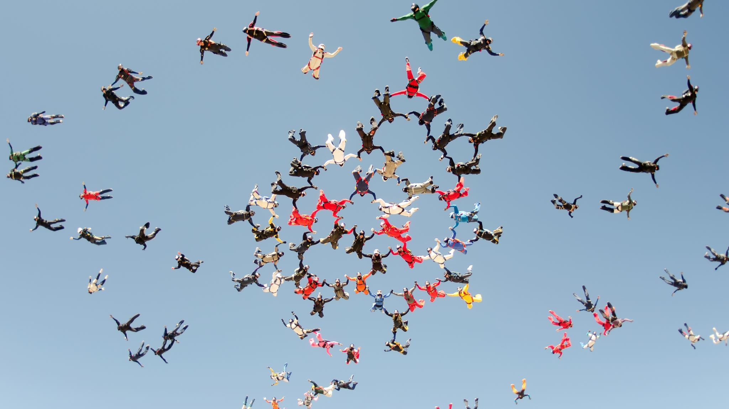
Experiences of the pandemic

Slide 11
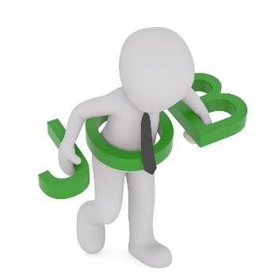
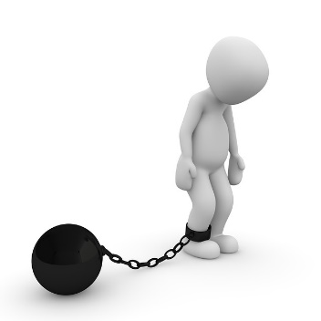
Understanding where your employees’ pandemic experiences
low
high

Slide 12
Emotional dynamics

Slide 13
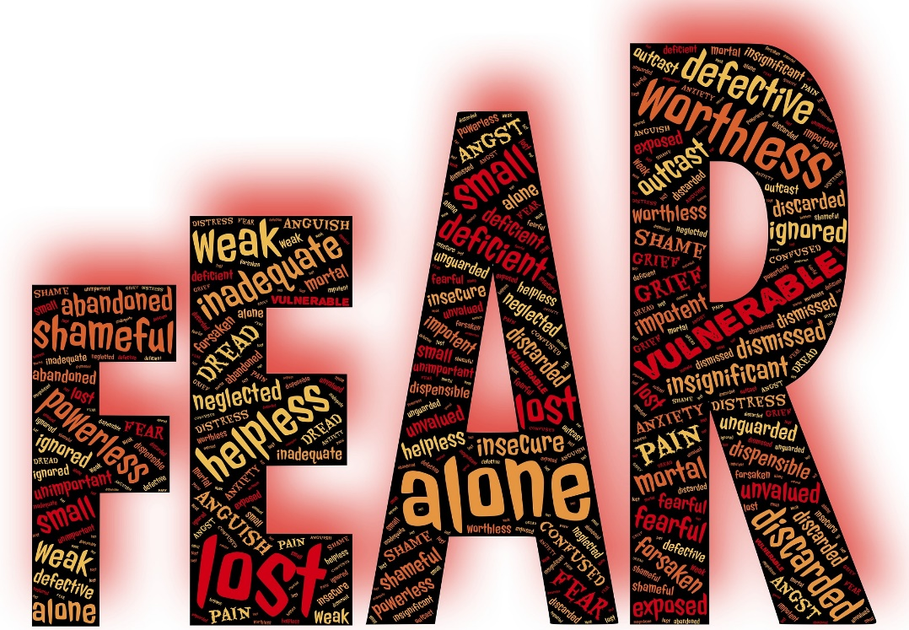
Emotions fuel negative behaviours

Slide 14
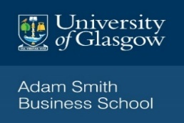
How to preserve organizational trust during a time of crisis Gustafsson, Gillespie, Searle, Hope-Hailey & Dietz (2020)
1. Cognitive Bridging – From past to the future – reduce uncertainty
2. Emotional embodying - Creating spaces to share, work through & shift neg emotions
3. Inclusive enacting – Participation in decisions – increasing sense of voice & agency
a. Leaders understanding their active role as Org guardians
b. Organization's trust repertoire – Drawing on prior social processes & structures, symbols, stories & rituals

Slide 15
Practice 2: Emotional embodying
Impact – reducing VULNERABILITY
Mechanism – acknowledging & working through emotions
Prioritizing emotions triggered by
disruption
Managing shock - Creating spaces to
share, work through & shift emotions
Reducing flight-fight responses
Coaching & reminding people capacity to cope
This Photo by Unknown Author is licensed under CC BY-NC-ND
This Photo by Unknown Author is licensed under CC BY-ND

Slide 16
Critical role HR

Slide 17
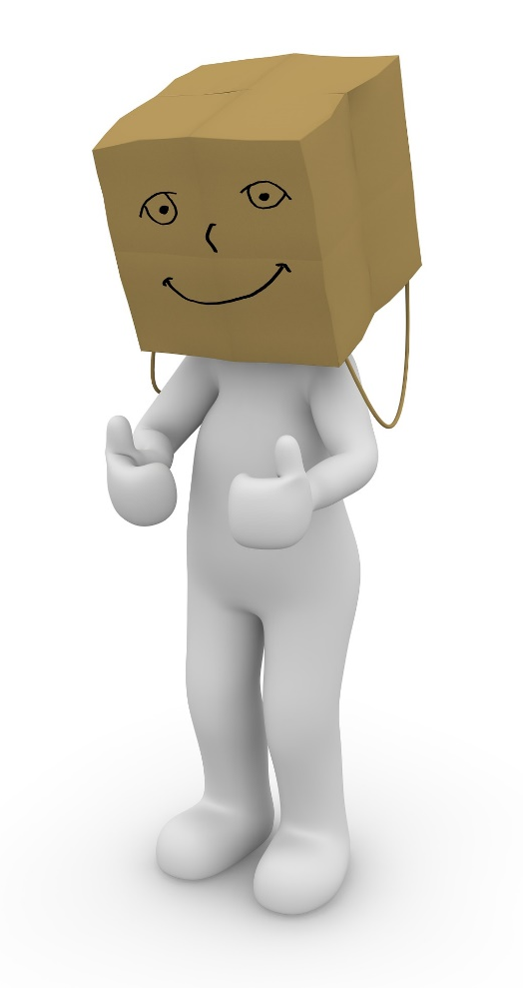
Resilient organisations
Preserving trust
Recognizing those with new resilience & skills
Offering timely front line support - Mental health first aiders
Living wages – restoring
It not about getting back to normal

Slide 18
Resources
Segmentation animation - https://crestresearch.ac.uk/resources/cwb-animation-organisational-change/
Gufstasson, S., Gillespie, N., Searle, R., Hope-Hailey, V. & Dietz, G. (2020). Preserving Organizational Trust During Disruption. Organization Studies.
https://journals.sagepub.com/doi/abs/10.1177/0170840620912705
Gillespie, N., Searle, R., Gufstasson, S. & Hope-Hailey, V. (2020) – practice focused free article
https://behavioralpolicy.org/articles/preserving-employee-trust-during-crisis-2/
www.eawopimpact.org.
Living wage animation launch 11 May
Threats and securities animation 8 June

Slide 19
Returning to the Workplace 26 April 2021

Slide 20
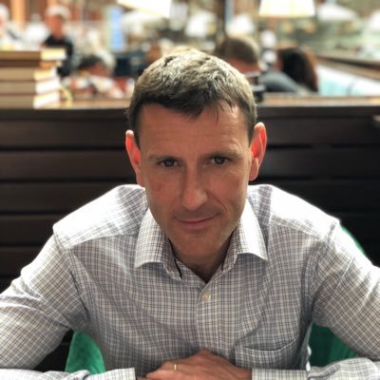
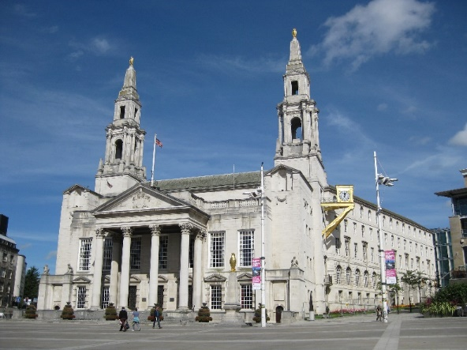
Andy
Dodman
LEEDS
CITY
Council
Chief HR Officer for Leeds City Council
Vice-President of PPMA
@AndyDodman1
Second largest Local Authority in UK
c. 27,000 staff
Empty 2 million bins a year
c. 450 services from A to Z

Slide 21
A changing world
Covid
Climate Emergency
Customer & staff expectations and behaviour
Digital advances
Financial & Estate Challenges
A growing, changing city
Our Framework for Future Working Arrangements = Broad context, transformational, long term & emphasis on the future of work not the place of work

Slide 22
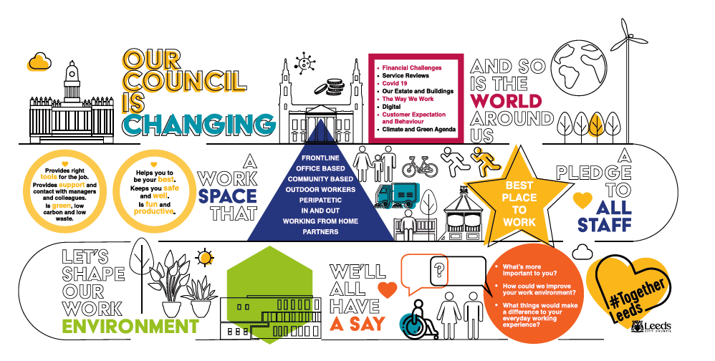
A pledge to all staff

Slide 23
For those 8,000+ colleagues who have been WFH
Service Need
What your team and customers need from you
Resources
What the Council can afford and provide
Individual choice
Your ideal way of working
Manager Toolkit to determine service needs & expectations
On-line survey to all 8000+ WFH staff to determine future working preferences
Our corporate expectations
People
Technology
Workplaces
And Spaces

Slide 24
Our Corporate Expectations & Principles
People
Staff continue to split time between home and workplace
Majority of people spend most of their time WFH
Everyone will have an agreed pattern, which can change
Everyone will spend regular time with their team in the workplace
Service Need
What your team and customers need from you
LCC Resources
What the Council can afford and provide
Individual choice
Your ideal way of working
Technology
Everyone will have the kit they need to WFH, in the workplace or on the go
Great user experience - MS teams, MS 365 & Hybrid Meetings
Workspaces and places
We will have fewer but better used buildings
Everyone will have a #Teamzone & everyone welcome elsewhere
Visits to the workplace will be for social interaction & collaboration

Slide 25
Our Next Steps & Support
Specific Support
Data Collection & Analysis (survey and toolkit)
Management Team Roadshows
Central Hub (email, online, social media) staffed by multi-disciplinary teams
Assurance
Covid-secure workplaces (hierarchy of measures)
Videos and photos of workplaces & Phased Returns
Call-backs
Corporate Governance & Reviews
Wider People Context
Talent Management Framework (performance/productivity, management development)
Relentless focus on Values, Wellbeing & Communications (Benefits Realisation)
City & System wide partnerships

Slide 26
Questions
Please submit your questions for:
David D’Souza, Director of Membership, CIPD
Professor Rosalind Searle, Chartered Psychologist, University of Glasgow
Andy Dodman, Chief HR Officer, Leeds City Council
Please use the Q&A function to submit your questions

Slide 27
#StrongerWithCIPD
Covid-19 resources
NEW Well-being helpline
Employment Law helpline
Communities and branches
People Management
Knowledge and content
Free learning
Careers support
Professional creditability
Financial support
cipd.co.uk/memberbenefits

