Slide 1
Enabling employee voice to facilitate a safe working environment
Webinar
Wednesday 18 October, 12:00 – 13:00
Global Ethics Day 2023

Slide 2
Welcome
Katie Jacobs
Senior Stakeholder Lead, CIPD

Slide 3
Today’s speakers
Tina Russell
Professional Conduct and Ethics Lead, CIPD
Andrew Pepper Parsons
Director of Policy and Communications, Protect
Katherine Bradshaw
National Lead for Communications and Engagement, National Guardians Office
Rachael Saunders
Deputy Director, Institute of Business Ethics

Slide 4
#StrongerWithCIPD
Covid-19 resources
NEW Well-being helpline
Employment Law helpline
Communities and branches
People Management
Knowledge and content
Free learning
Careers support
Professional creditability
Financial support
cipd.org/uk/membership/member-benefits/

Slide 5
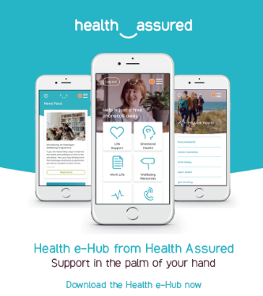
Wellbeing Resources
We’ve partnered with Health Assured to support members mental health and wellbeing
Unlimited free 24/7 confidential telephone helpline, online portal & Health e-Hub app
The resource provides:
Legal information
Debt and financial information
Manager consultancy and support
Information on work and home issues
Factsheets, advice, information and self-help tools
Links to specialist support organisations
A resources area with; programmes, videos, webinars, medical information and mini health checks.

Slide 6
Tina Russell
Professional Conduct and Ethics Lead, CIPD

Slide 7
EU Directive (EU) 2019/1937
Defined what is a whistleblower
Three tier reporting system including protocols
Who is protected
Protects privacy & confidentiality
National authorities in EU member states
Protection from retaliation
Timely and effective responses
Training and awareness
Applies to all organisations with 50+ employees and/or with an annual turnover of 10 million euros
Also to local authorities serving 10,000 people or more
Organisations with 250+ employees were to be compliant by December 17, 2021
Organisations with 50-249 employees must comply before December 17, 2023.

Slide 9
CIPD Resources
https://www.cipd.org/uk/knowledge/employment-law/whistleblowing/
https://www.cipd.org/uk/knowledge/guides/ethics-work-guide/
https://community.cipd.co.uk/discussion-forums/workplace-dilemmas-in-confidence/
https://www.cipd.org/uk/membership/member-benefits/helplines/employment-law-helpline/
https://commission.europa.eu/system/files/2018-04/placeholder_11.pdf
https://eur-lex.europa.eu/legal-content/EN/TXT/PDF/?uri=CELEX:32019L1937

Slide 10
Thank you
ethics@cipd.co.uk

Slide 11
Andrew Pepper Parsons
Director of Policy and Communications, Protect

Slide 12
Awareness- our research found that only 34% of UK workers say they know how to raise concerns (YouGov Survey 2021).
Fear of retaliation- 60-70% of whistleblowers calling Protect for advice are victimised, dismissed or resign after raising their concerns (Protect Advice Line).
Fear that nothing will change- 30-40% of whistleblowers calling Protect for advice say they felt ignored.
Key barriers to whistleblowing or speaking up

Slide 13
A far wider scope of workers are protected by the directive compared to UK protection
There are legal requirements on organisations to have whistleblowing arrangements
There are legal standards on regulators in the way they deal with whistleblowers
Where the EU Directive on whistleblowing is more advanced

Slide 14
Key Principles for Effective Whistleblowing Arrangements
Communicate your policies
and
processes
Tone from the top
Training – all, line managers, investigators
Assess staff engagement and confidence
Share good practice
We’re very happy to support organisations in creating and assessing
andrew@protect-advice.org.uk
02034552252

Slide 15
Katherine Bradshaw
National Lead for Communications and Engagement,
National Guardians Office

Slide 16
What are we talking about?
Speaking up is all of these
Improvement suggestions
Making a disclosure
Raising a concern
Staff survey responses
Taking out
a grievance
Whistleblowing
Making a
qualifying disclosure
Making a complaint
Feedback

Slide 17
Freedom to Speak Up Guardians
Provide an additional channel for speaking up
Thank people who speak up, help them decide on next steps and may escalate a matter on their behalf
Ensure that action is taken and that feedback is given throughout and at the end of a process. Asks for feedback from those they support.
Raise awareness of speaking up and help identify and address any barriers, by sharing themes to senior leaders so that the information can be used for learning and improvement

Slide 18
Speak Up Listen Up Follow Up

Slide 19
Rachael Saunders
Deputy Director, Institute of Business Ethics

Slide 20
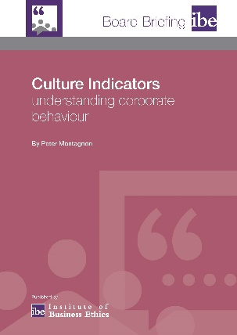
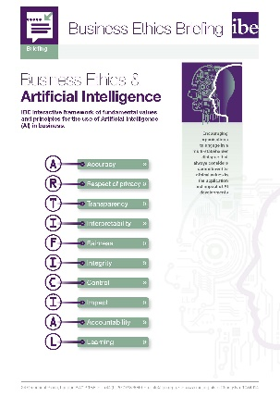
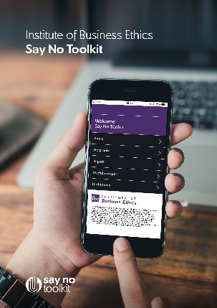
About the IBE
The IBE was established in 1986 to champion the highest standards of ethical behaviour in business.
Research & thought
leadership
Knowledge hub
Advisory services
Networking & Forums
Training
Events
ibe.org.uk

Slide 21
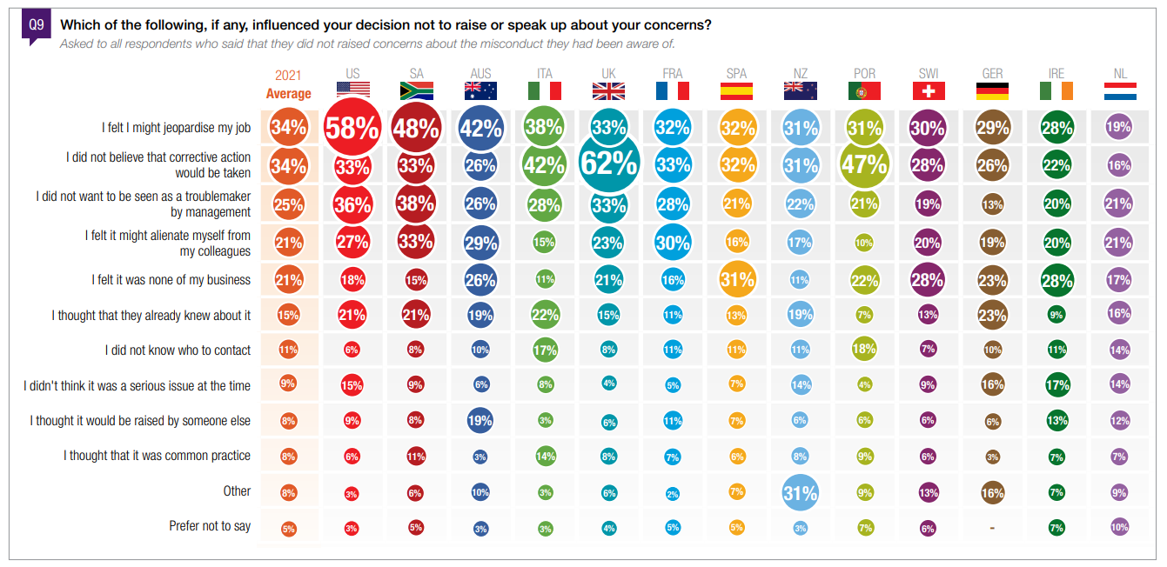
Why don’t people speak up?
Source: IBE (2021) Ethics at Work: 2021 survey of employees

Slide 22
Creating a speak up culture
Speak Up
Listen Up
Follow Up

Slide 24
Questions
Please share any questions you have for our panellists using the Q&A tab.

Slide 25
Wellbeing Resources
We’ve partnered with Health Assured to support members mental health and wellbeing
Unlimited free 24/7 confidential telephone helpline, online portal & Health e-Hub app
The resource provides:
Legal information
Debt and financial information
Manager consultancy and support
Information on work and home issues
Factsheets, advice, information and self-help tools
Links to specialist support organisations
A resources area with; programmes, videos, webinars, medical information and mini health checks.

