Slide 1
CIPD webinar series
Raising your employee value proposition
10 March 2022

Slide 2
Welcome
Charlotte Chedeville
Regional Head of Operations – Middle East, CIPD

Slide 3
Today’s speakers
Charlotte Chedeville
Regional Head of Operations –
Middle East, CIPD
Jon Boys
Labour Market Economist, CIPD
Florencio Rhency Padilla,
Founder and Managing Director,
Perky People
Christine Belanger
Senior Director – Rewards, Performance & Workforce Effectiveness,
Mubadala Health

Slide 4
#StrongerWithCIPD
Covid-19 resources
NEW Well-being helpline
Employment Law helpline
Communities and branches
People Management
Knowledge and content
Free learning
Careers support
Professional creditability
Financial support
cipd.co.uk/memberbenefits

Slide 5
*New* Wellbeing Resources
We’ve partnered with Health Assured to support members mental health and wellbeing
Unlimited free 24/7 confidential telephone helpline, online portal & Health e-Hub app
The resource provides:
Legal information
Debt and financial information
Manager consultancy and support
Information on work and home issues
Factsheets, advice, information and self-help tools
Links to specialist support organisations
A resources area with; programmes, videos, webinars, medical information and mini health checks.

Slide 6
Raising your employee value proposition Setting the scene
Jon Boys – Labour market economist
@CIPD

Slide 7
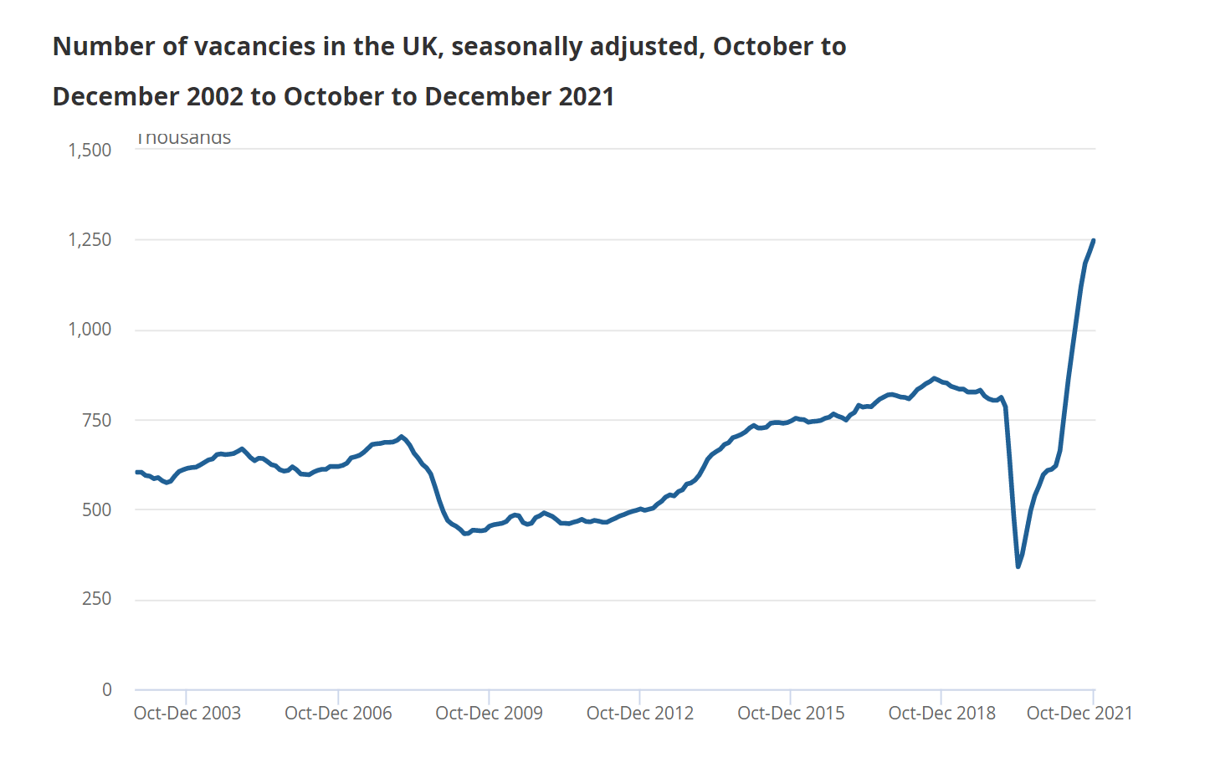
Job ads above pre-pandemic levels

Slide 8
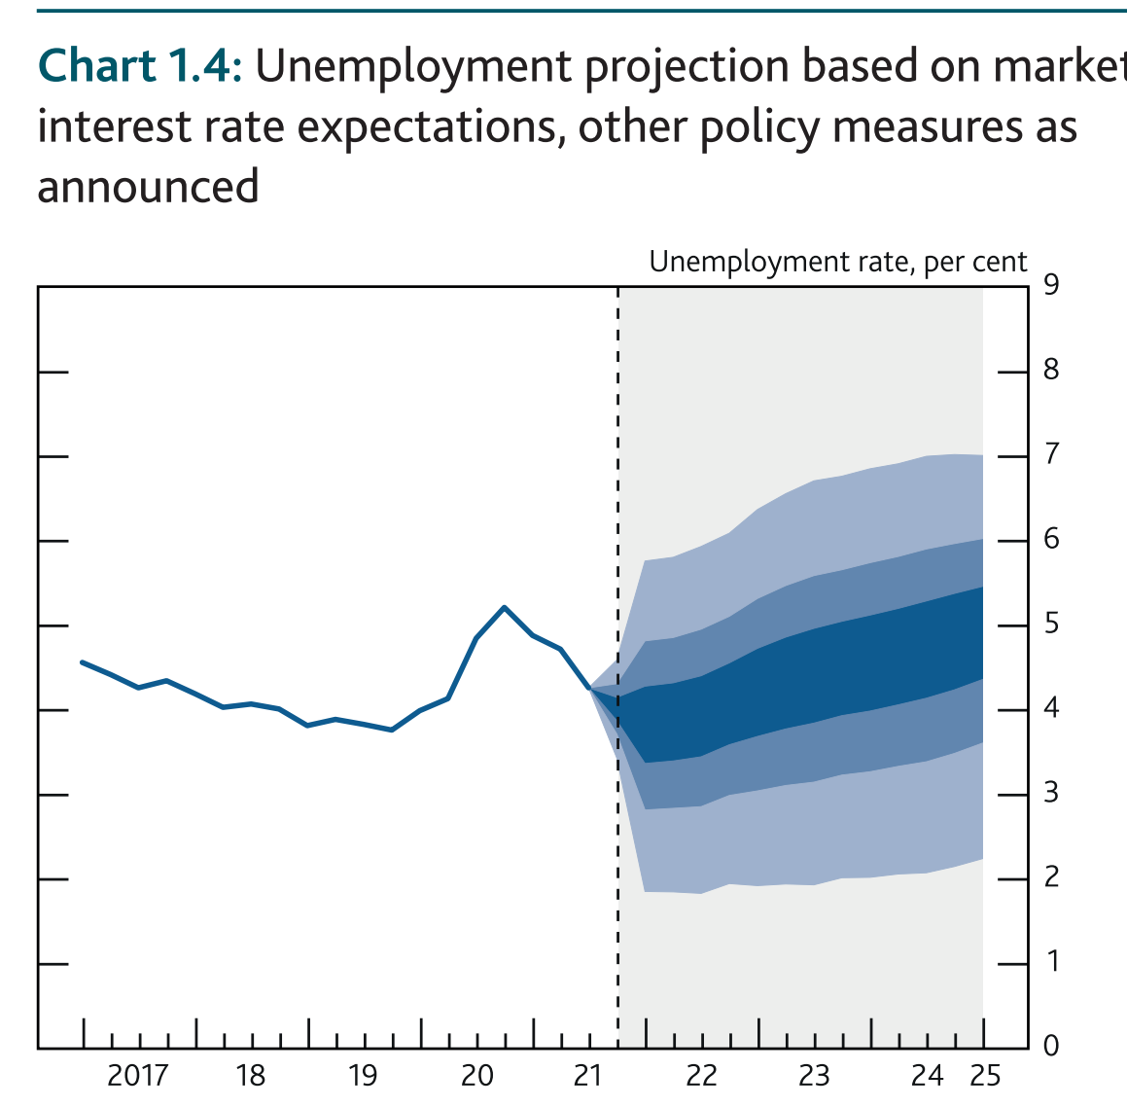
Unemployment - Low
The Labour Force Survey
Unemployment rate fell to 4.1% in the three months to November, and is expected to fall further in the near term, to 3.8% in 2022 Q1.
……..but then again a lot has changed since this forecast published on 3 Feb.

Slide 9
Great resignation?

Slide 10
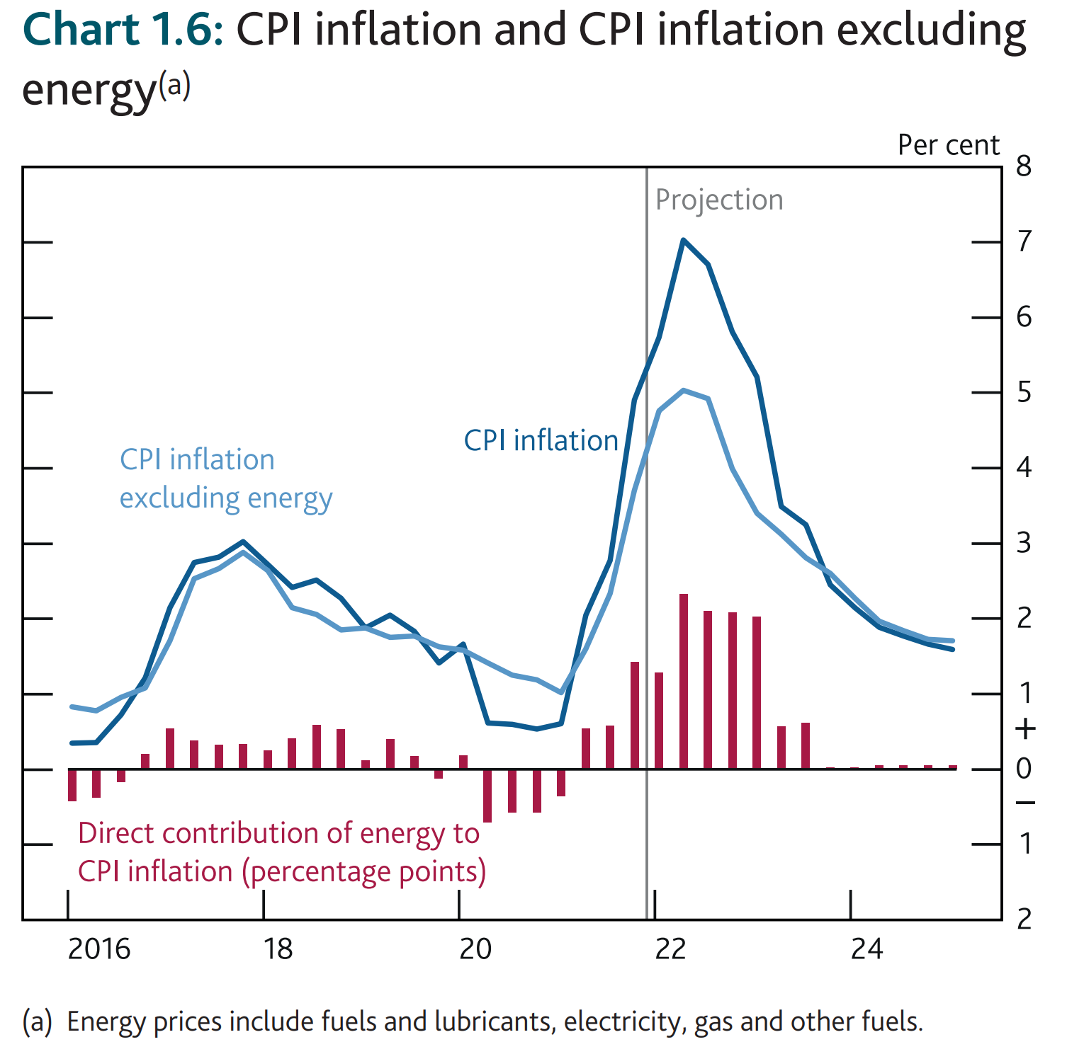
Inflation - High
“Inflation is expected to increase further in coming months, to close to 6% in February and March, before peaking at around 7¼% in April.”
This forecasts could already be out of date. Since the Bank of England published this report on 3 Feb, a war has broken out in Europe. Energy prices could rise even further.

Slide 11
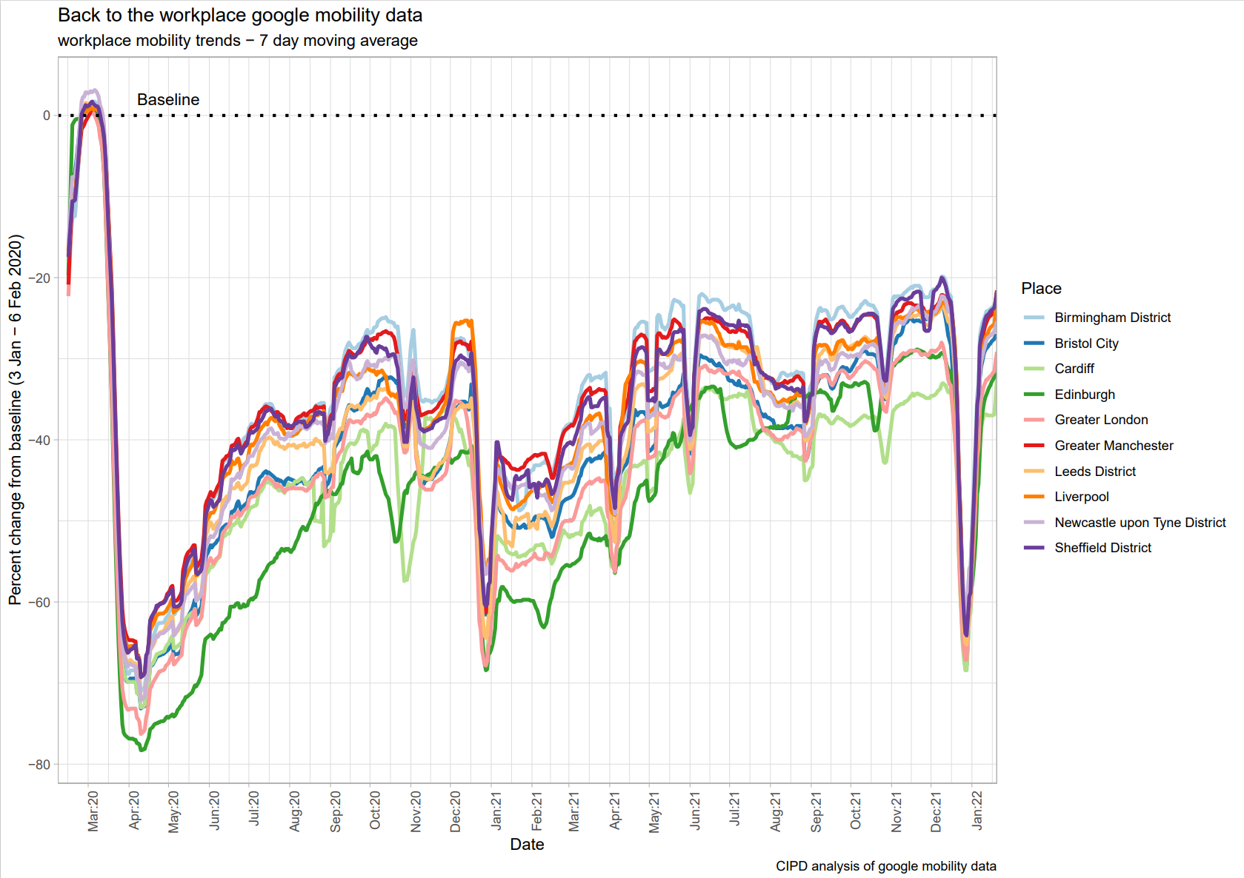
Back to the office?

Slide 12
Florencio Rhency Padilla
Founder and Managing Director,
Perky People

Slide 13
Christine Belanger
Senior Director – Rewards, Performance & Workforce Effectiveness,
Mubadala Health

Slide 14
Questions
Please submit your questions for:
Jon Boys, Labour Market Economist, CIPD
Florencio Rhency Padilla, Founder and Managing Director, Perky People
Christine Belanger, Senior Director – Rewards, Performance & Workforce Effectiveness, Mubadala Health
Please use the Q&A function to submit your questions

Slide 15
*New* Wellbeing Resources
We’ve partnered with Health Assured to support members mental health and wellbeing
Unlimited free 24/7 confidential telephone helpline, online portal & Health e-Hub app
The resource provides:
Legal information
Debt and financial information
Manager consultancy and support
Information on work and home issues
Factsheets, advice, information and self-help tools
Links to specialist support organisations
A resources area with; programmes, videos, webinars, medical information and mini health checks.

Slide 16
#StrongerWithCIPD
Covid-19 resources
NEW Well-being helpline
Employment Law helpline
Communities and branches
People Management
Knowledge and content
Free learning
Careers support
Professional creditability
Financial support
cipd.co.uk/memberbenefits

